Slide 1
Neurospiritual Health and Healing
By
Paul D. Nussbaum, Ph.D., ABPP
www.brainhealthctr.com
(412) 471-1195

Slide 2
Paul D. Nussbaum, Ph.D., ABPP
Board Certified Clinical and Geropsychology
Fellow National Academy of Neuropsychology
National Register Health Services Psychologists
Adjunct Professor of Neurological Surgery
University of Pittsburgh School of Medicine
www.brainhealthctr.com
(412) 471-1195

Slide 3
Facts and Statistics Anxiety and Depression
(Anxiety and Depression Association of America-ADAA-2024)
23% of American Adults suffer Mental Health issues (2021 Substance Abuse and Mental Health Services Administration-SAMHSA)

Slide 4
Generalized Anxiety Disorder (GAD)
GAD affects 6.8 million Adults (3.1%)
43% receive treatment
Women 2x affected vs. men
Most common anxiety disorder in older adults

Slide 5
Generalized Anxiety Disorder (GAD)
Panic Disorder affects 6 million adults (2%)
Women 2x affected vs. men
Social Anxiety Disorder affects 15 million or 7.1%
SAD is common men and women

Slide 6
Generalized Anxiety Disorder (GAD)
Phobias affect 19 million (9.1%)
Women 2x versus men
OCD (2.5 million=1.2%) Women 3x vs men
PTSD (7.7 million=3.6%) Women 5x vs men

Slide 7
Major Depression (MDD)
21.4% suffer symptoms of MDD
7% moderate or severe symptoms of MDD
8.3% experienced a MDD episode in 2021
6% men and 8% women (USAFactsTeam 2023)

Slide 8
Treatment Options:
Psychotherapy
Medication
Complementary and Alternative (Yoga, Breathing, Visualization, Meditation, etc)
Transcranial Magnetic Stimulation
ECT
Mental Health America: State of Mental Health in America 2020 Report
APA: Stress in America: A National Mental Health Crisis (Oct 2020)

Slide 9
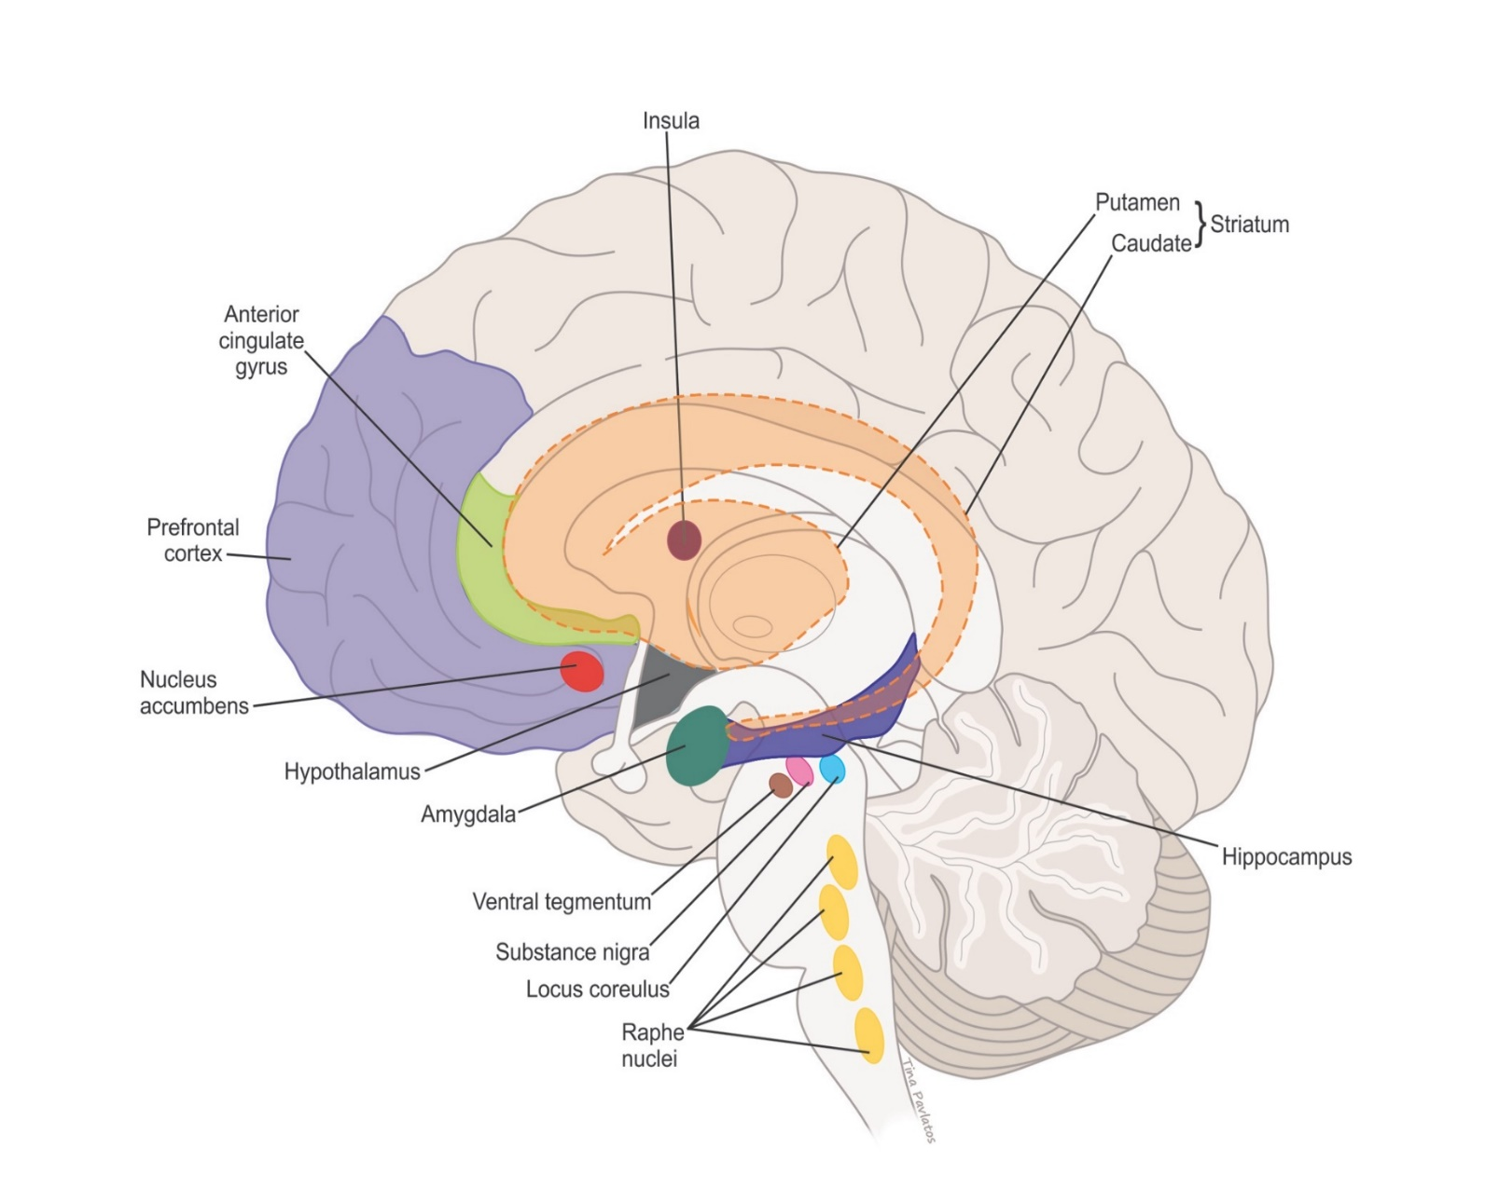
Reward Systems of the Brain

Slide 10
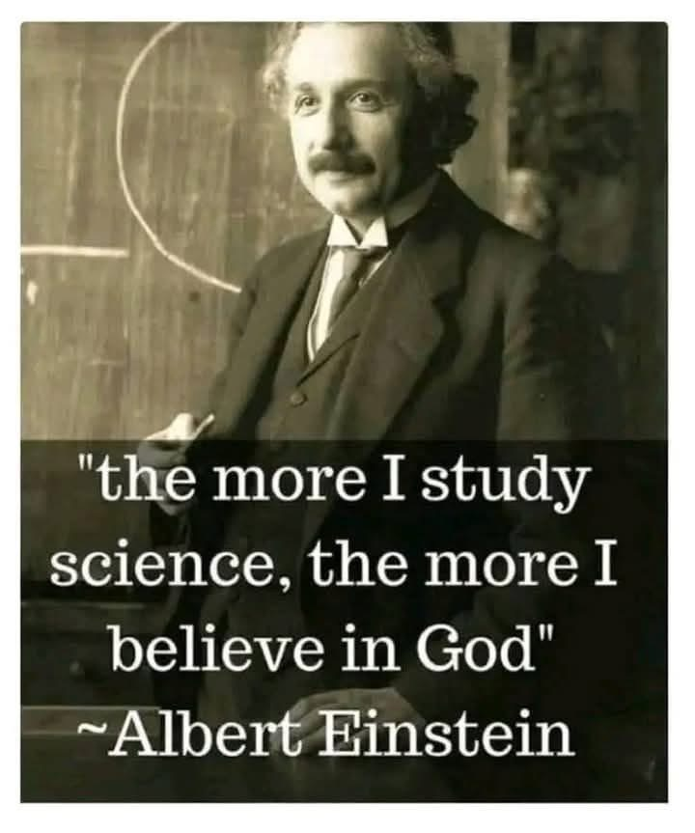
Science and God

Slide 11
Spiritual Health
Science and Religion: Is there really a Difference?
On the Bing Bang and our Universe (finite, a true beginning)
Genesis and 6 days vs. 15 billion years
Einstein, Time and Theory of Relativity
Nautilus Shape of Milky Way and Universe (seashells, sunflower, brain, hurricane, etc)
200 billion stars in Milky Way, 200 billion neurons in brain, 10x glial cells, 43 trillion cells in human body
Creator-not Random-God is a Mathematician

Slide 12
God-Jesus Christ-and Faith
Bible (66 books, 40 Authors, 1500 years, 3 languages, changed the world)
Old Testament Predictions (Birth-Death-Resurrection and Crucifixion)
Human behavior continues to be shaped-Why
Emotional responses (joy to anger)
Not generational (“end of time”)
Earthbound versus a Higher Power

Slide 13
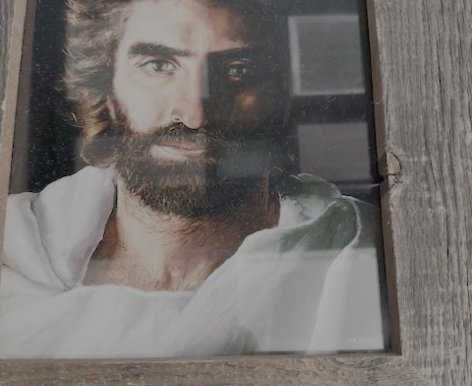
“Do Not Be Afraid” is the most repeated phrase (365x) in the Bible........
Akiane Kramarik: As 4-year-old had visions of Jesus and God Spoke to her to paint her visions and she completed this picture “Prince of Peace” at age 8.

Slide 14
Historical Evidence for Consideration
Bible: Why write and detail Experiences?
Archeological Findings: Dead Sea Scrolls (1946-1956), Pool of Shilom (June 2004), Shroud of Turin, bones of St. Peter
Old Testament Predictions Tie to New Testament Writings
Miracles and Mystical experiences
Near Death Experiences (NDE)

Slide 15
Near Death Experiences-What Do they Suggest?
Book of Revelations-St. John or other
Reliability of Authors?
Consistency of Stories?
Christians, Muslims, Jewish, Hindu, Atheists
What is the purpose of NDEs?
Why do we all not have NDEs-Why did Christ not Heal Everyone?

Slide 16
What are My Takeaways from the NDE’s
Peace without Pain or Fear
Removal from Body
Consciousness Exists-Witness What is Happening around Body
Details of Experience and Surrounding Area Provided (shoes on the outside window)
Movement Upwards and Away
Light and Tunnel
No Desire to Return to Earth
Sense of Other-Sometimes Familiar Family
Meeting of Siblings, etc. never born
Vivid Colors and Brightest of Lights Unable to Describe

Slide 17
What are My Takeaways from the NDE’s
Sound of Music Like Language and Blessings
Sight of Large Walled Kingdom-Like Wall of Jerusalem (“on Earth as it is in Heaven”)
Glass like roads with Water Beneath
Animals
Life Review that is non-judgmental
Presence of a Loving Person or Spirit
Jesus Christ is Recognized Regardless of Earthly Beliefs
Recognition of 3 in 1
Overwhelming Love
Large Altar with Brightest of Lights and Three Thrones

Slide 18
What are My Takeaways from the NDE’s
There is no Time
Everything is present all at once and sight is endless
Persons Appear Young
Family and Friends Interact
There are no Disabilities and no Sadness
There is no Night and Day
There is no Light needed as GOD is the Light That Illuminates
Nobody Wants to Return to Earth-though Some Do Per God’s Instructions
Everyone with NDE is Changed to Core (Churches Built, Conversion, No Worry, etc)

Slide 19
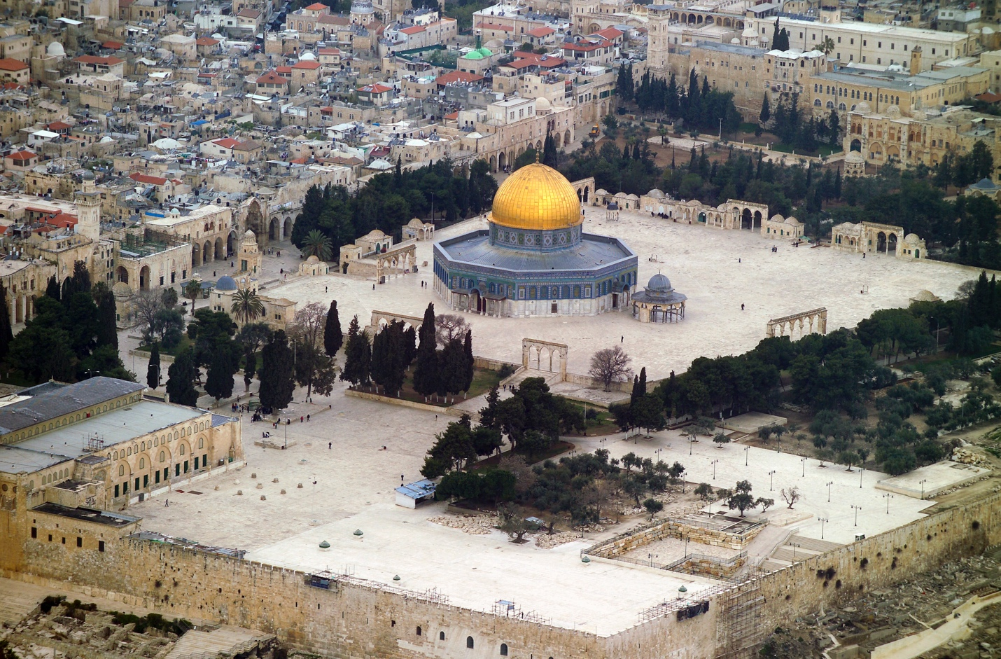

Slide 20
What is the Purpose of the NDE?
We are No Different from Peter and the Doubting Disciples (Boat, Breaking of Loaves, Resurrection...)
Jesus Has Always Provided Evidence-We are Not Always Open-We Doubt
NDE is Perhaps Another Example of God’s Presence
What is Your Faith and Spiritual Health?
Hope, Faith, and Trust
Have we Learned from What Has Been and What Is?

Slide 21
What Is Jesus Telling Us?
God is Relational-He wants to be With You and Is With You
He told us Who He Is and He Never Changed
He told us He is With Us until the End of Time
He told us Not To Be Afraid
He told Us Our Faith Will Heal and Save Us
God does not conform to us, We need to conform to his word

Slide 22
What Is Jesus Telling Us?
He told Us Our Salvation is the Reward of Heaven
He told Us to Love One Another and to Forgive All who Offend Us
Our Body is a Shell and Our Spirit is Forever
We are Spiritual Beings inside A Human Body

Slide 23
Neurospiritual Factors and Health
Love
Forgive
Kindness
Empathy (How I feel for)
Compassion (What I do for)
Hope
Gratitude
Faith
Order
Charity
Divorce from self
Humility
Give anxiety and guilt away
Legacy

Slide 24
Final Considerations
“We Should Not Be Afraid or Anxious About Death but Rather Be Excited About What We Will Experience With God in Heaven.”
God is with us now if we only are open and experience him now.
Do not view or imagine God in Human Ways but Rather be Open to How God Wants to Show Himself to You Now.
Faith and Trust in God and What Awaits in Heaven can help Ease or Erase Anxiety on Earth.
Prayer and Growing Closer to God is the Way!

Slide 25
Reward Systems of the Brain

Slide 26
Matthew 6:25-34
”Therefore I say to you, do not worry about your life, what you will eat or what you will drink; nor
about your body, what you will put on. Is not life more than food and the body more than clothing?
Look at the birds of the air, for they neither sow nor reap not gather into barns: yet your heavenly
Father feeds them. Are you not of more value than they? Which of you by worrying can one cubit to
his stature? So why do you worry about clothing? Consider the lilies of the field, how they grow: they
Neither toil nor spin: and yet I say to you that even Solomon in all his glory was not arrayed like one of
these. Now, if God so clothes the grass of the field, which today is and tomorrow is thrown into the
oven, will He not much more clothe you. O you of little faith? Therefore, do not worry, saying “what
shall we eat? or What shall we wear? For after all these things you seek, your heavenly Father
Knows that what you need. But seek first the kingdom of God and His righteousness, and all these
things shall be added to you. Therefore, do not worry about tomorrow for tomorrow will worry about
Its own things.”

Slide 27
References for NDE’s
The Bible
The Case for Christ (2016), Strobel , L.
The Science of God (1997), Schroder, G. L.
7 Lessons from Heaven (2017), Neal, M., M.D.
Touching Heaven (2015), Crandall, C. M.D.
Imagine The God of Heaven (2013), Burke J.
Imagine Heaven (2015), Burke, J

